Slide 1
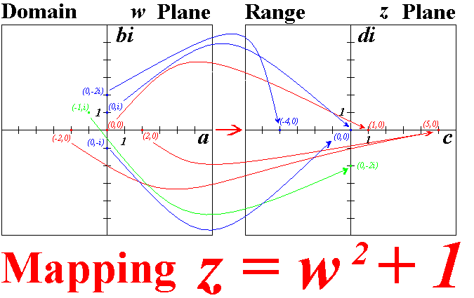
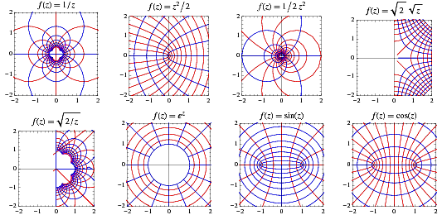
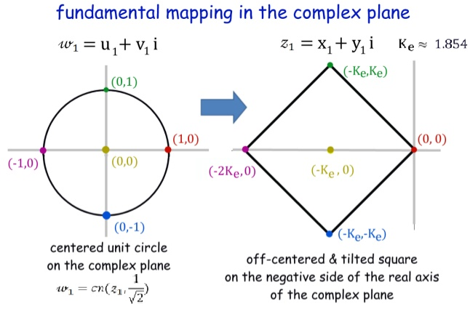
Complex Functions

Slide 2

2
Complex Functions and Mappings
Book: A First Course in Complex Analysis with Applications by Dennis G. Zill and Patrick D. Shanahan.

Slide 3
Introduction
In the previous lectures we talked about complex numbers and examined some of their algebraic and geometric properties.
Now we turn our attention to the study of functions from a set of complex numbers to another set of complex numbers.
Unlike the functions studied in elementary calculus, we shall see that we cannot draw the graph of a complex function. Therefore, we introduce the notion of a mapping as an alternative way of graphically representing a complex function.

Slide 4
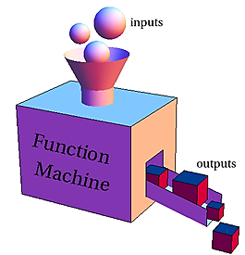

Functions
One of the most important concepts in mathematics is that of a function. A function is a certain kind of correspondence between two sets; more specifically:
A function f from a set $A$ to a set $B$ is a rule that assigns
to each element in $A$ one and only one element in $B$.
We often think of a function as a rule or a machine that accepts inputs from the set A and returns outputs in the set B. For instance, a real function is a function whose inputs and outputs are real numbers.
The set A—the set of inputs—is called the domain of f and the set of images in B—the set of outputs—is called the range of f. We denote the domain and range of a function f by Dom(f) and Range(f), respectively.

Slide 5
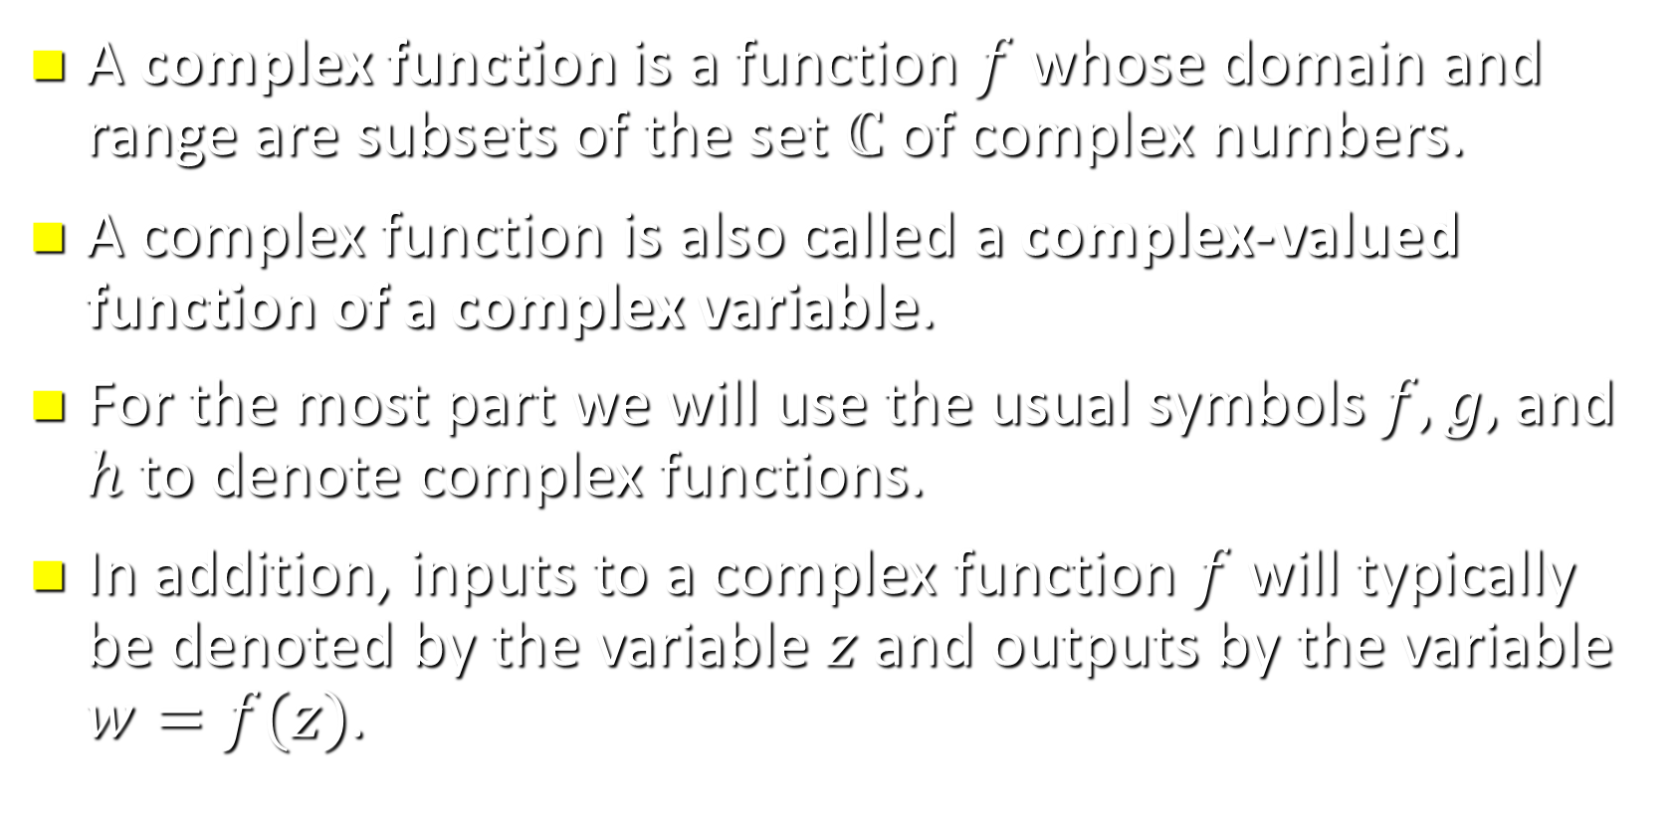
2.1 Complex Functions
A complex function is a function $f$ whose domain and range are subsets of the set $ℂ$ of complex numbers.
A complex function is also called a complex-valued function of a complex variable.
For the most part we will use the usual symbols $f, g,$and $h$ to denote complex functions.
In addition, inputs to a complex function $f$ will typically be denoted by the variable $z$ and outputs by the variable $w=f(z)$.

Slide 6
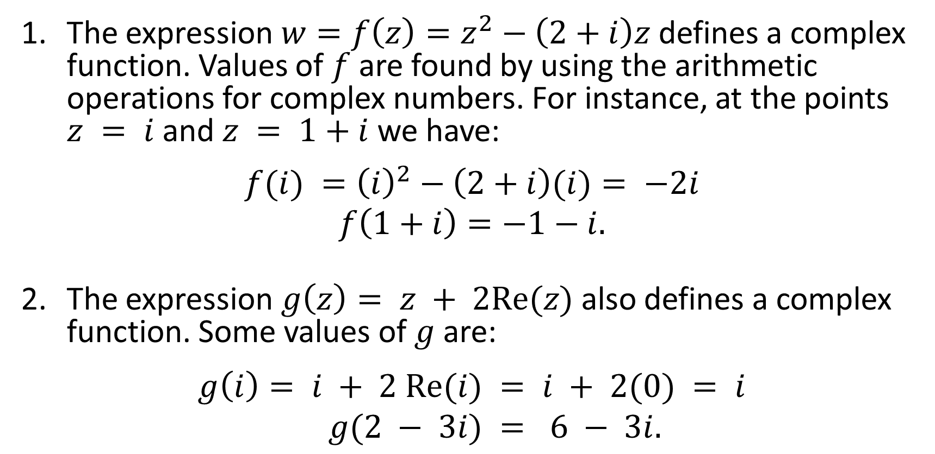
Examples:
The expression $w=f\left(z\right)=z^{2}−\left(2+i\right)z$defines a complex function. Values of $f$are found by using the arithmetic operations for complex numbers. For instance, at the points $z = i$and $z = 1+i$ we have:
$$f(i) ={\left(i\right)}^{2}−\left(2+i\right)(i)= −2i$$
$$f\left(1+i\right)=−1−i.$$
The expression $g\left(z\right)= z + 2Re(z)$also defines a complex function. Some values of $g$are:
$$g\left(i\right)= i + 2 Re(i) = i + 2(0) = i$$
$$g(2 − 3i) = 6 − 3i.$$

Slide 7
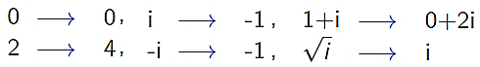
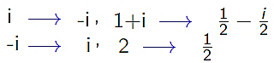
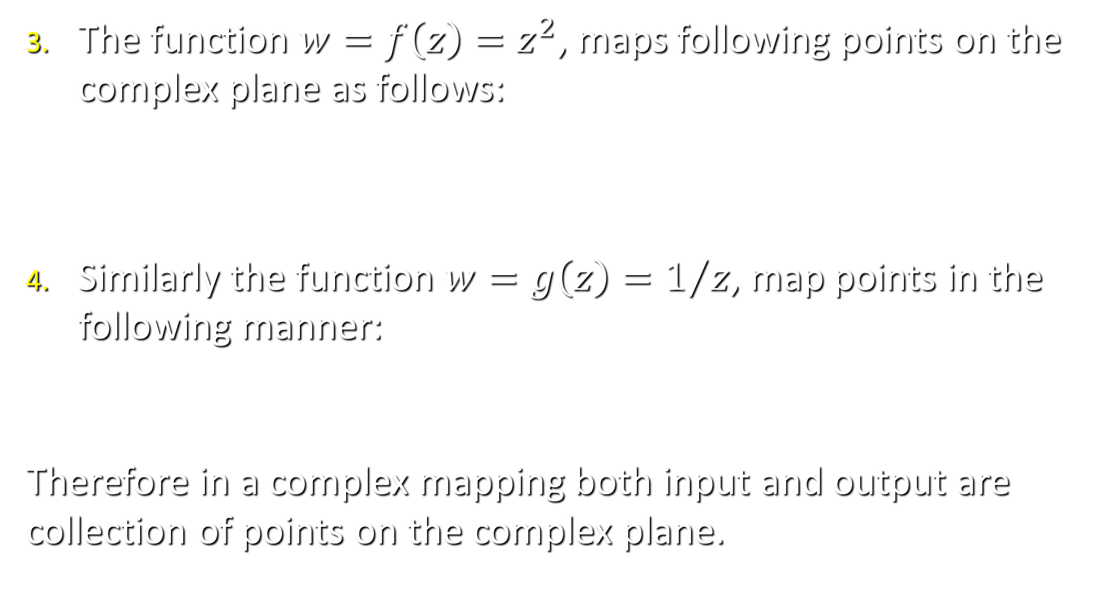
Examples:
The function $w=f\left(z\right)=z^{2}$, maps following points on the complex plane as follows:
Similarly the function $w=g\left(z\right)=1/z$, map points in the following manner:
Therefore in a complex mapping both input and output are collection of points on the complex plane.

Slide 8
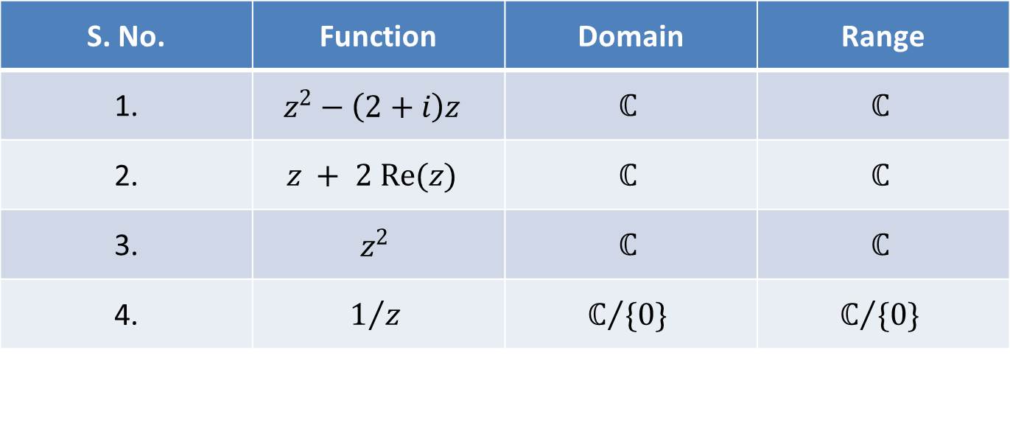
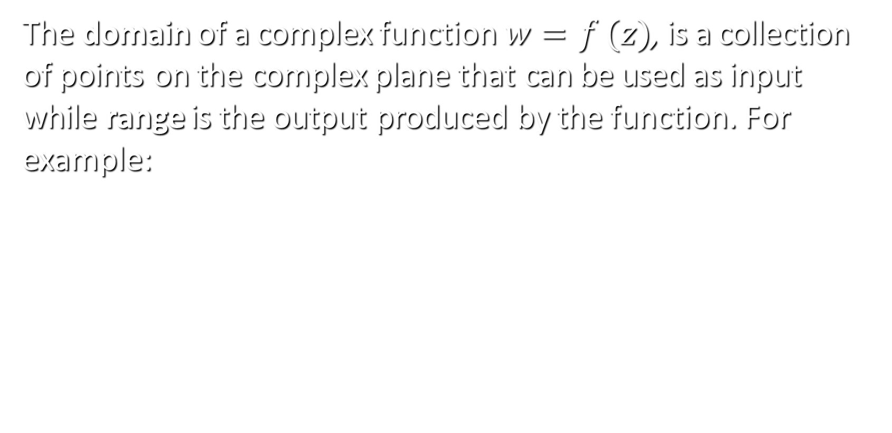
Domain & Range
The domain of a complex function $w=f (z)$, is a collection of points on the complex plane that can be used as input while range is the output produced by the function. For example:
S. No. | Function | Domain | Range
1. | $$z^{2}−\left(2+i\right)z$$ | $$ℂ$$ | $$ℂ$$
2. | $$z + 2 Re(z)$$ | $$ℂ$$ | $$ℂ$$
3. | $$z^{2}$$ | $$ℂ$$ | $$ℂ$$
4. | $$1/z$$ | $$ℂ/{\{0\}}$$ | $$ℂ/{\{0\}}$$

Slide 9
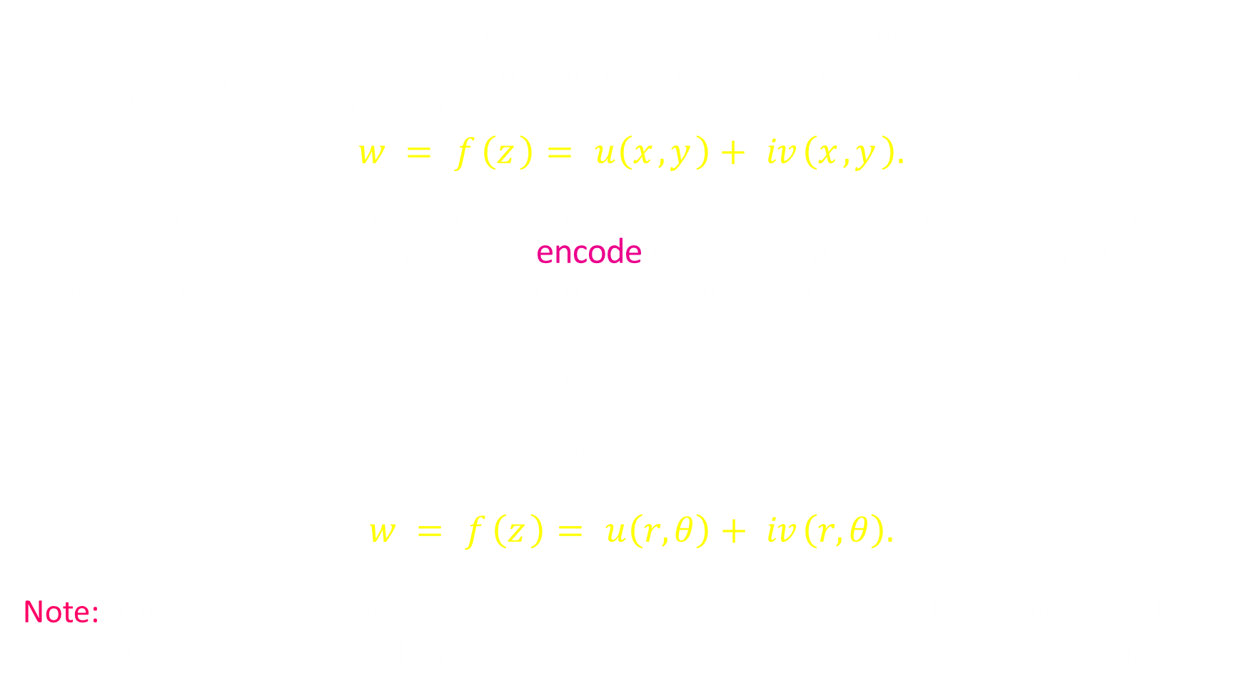
Real and Imaginary Parts of a Complex Function
In general, the function $w =f (z)$ is complex, and we write $w=u+iv,$ where $u$ and $v$ are respectively the real and imaginary parts of $w$. Now $w$ depends on $z=x+iy.$ We may thus write
$$w = f \left(z \right)= u\left(x , y \right)+ iv \left(x , y \right).$$
where both $u$ and $v$ are real multi-variable functions of $x , y$. Therefore a complex function just like complex numbers encode the information of two real multi-variable functions. If the polar coordinates $r$ and $θ$, instead of $x$ and $y$, are used, then
$$w=u + iv = f ({re}^{iθ})$$
where $z ={re}^{iθ}$. In that case, we may write
$$w = f \left(z \right)= u\left(r,θ\right)+ iv \left(r,θ\right).$$
Note: If, in either of equations $(1)$ and $(2)$, the function $v$ always has value zero, then
the value of $f$ is always real. That is, $f$ is a real-valued function of a complex variable.
(1)
(2)

Slide 10
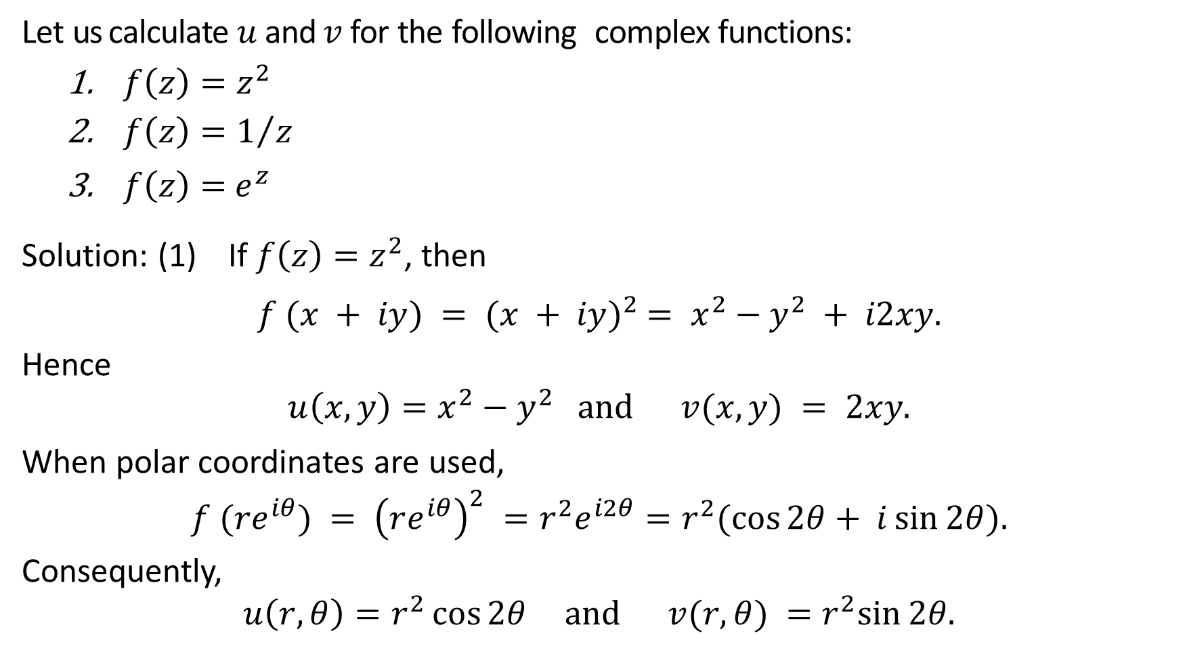
Examples:
Let us calculate $u$and $v$ for the following complex functions:
$f\left(z\right)=z^{2}$
${f\left(z\right)=1}/z$
$f\left(z\right)=$ $e^{z}$
Solution: (1) If $f\left(z\right)=z^{2}$, then
$$f (x + iy) = {(x + iy)}^{2} = x^{2}−y^{2} + i2xy.$$
Hence
$$u\left(x, y\right)=x^{2}−y^{2} and v(x, y) = 2xy.$$
When polar coordinates are used,
$$f ({re}^{iθ}) = {\left(re^{iθ}\right)}^{2} =r^{2}e^{i2θ}=r^{2}(\cos{2θ}+ i\sin{2θ}).$$
Consequently,
$$u\left(r, θ\right)=r^{2}\cos{2θ} and v(r, θ) =r^{2}sin⁡2θ.$$

Slide 11
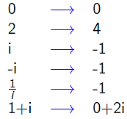

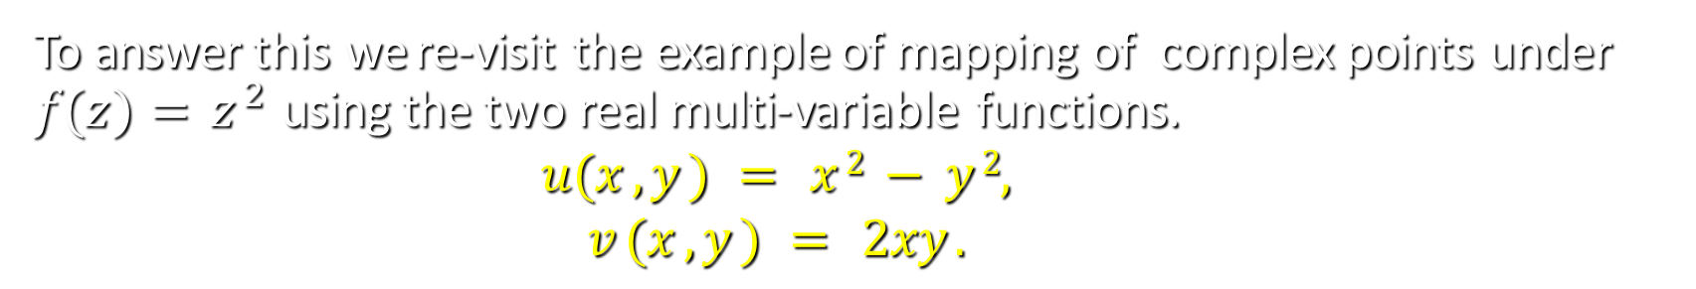
How to Map complex points to complex points?
To answer this we re-visit the example of mapping of complex points under $f(z)=z^{2}$ using the two real multi-variable functions.
$$u(x , y ) = x 2 − y 2,$$
$$v (x , y ) = 2xy .$$
As discussed the function $f(z)=z^{2}$, maps the following points on the complex plane:
which can be viewed from the multi-variables functions as follows.

Slide 12
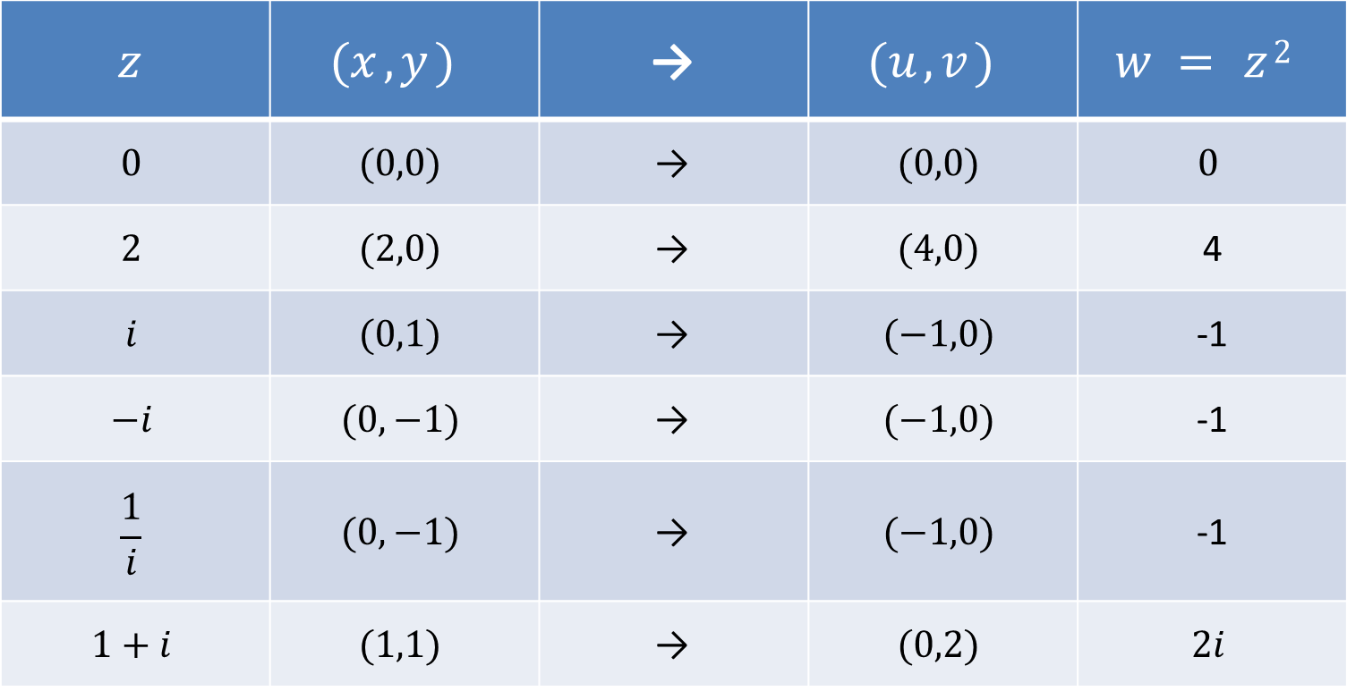
How to Map complex points to complex points?
$$w=f \left(z\right)=z 2=\left(x 2−y 2 \right)+i(2xy)=u+iv$$
$$z$$ | $$(x , y )$$ | → | $$(u , v )$$ | $$w = z 2$$
$$0$$ | $$(0,0)$$ | → | $$(0,0)$$ | $$0$$
$$2$$ | $$(2,0)$$ | → | $$(4,0)$$ | 4
$$i$$ | $$(0,1)$$ | → | $$(−1,0)$$ | -1
$$−i$$ | $$(0,−1)$$ | → | $$(−1,0)$$ | -1
$$\frac{1}{i}$$ | $$(0,−1)$$ | → | $$(−1,0)$$ | -1
$$1+i$$ | $$(1,1)$$ | → | $$(0,2)$$ | $$2i$$

Slide 13
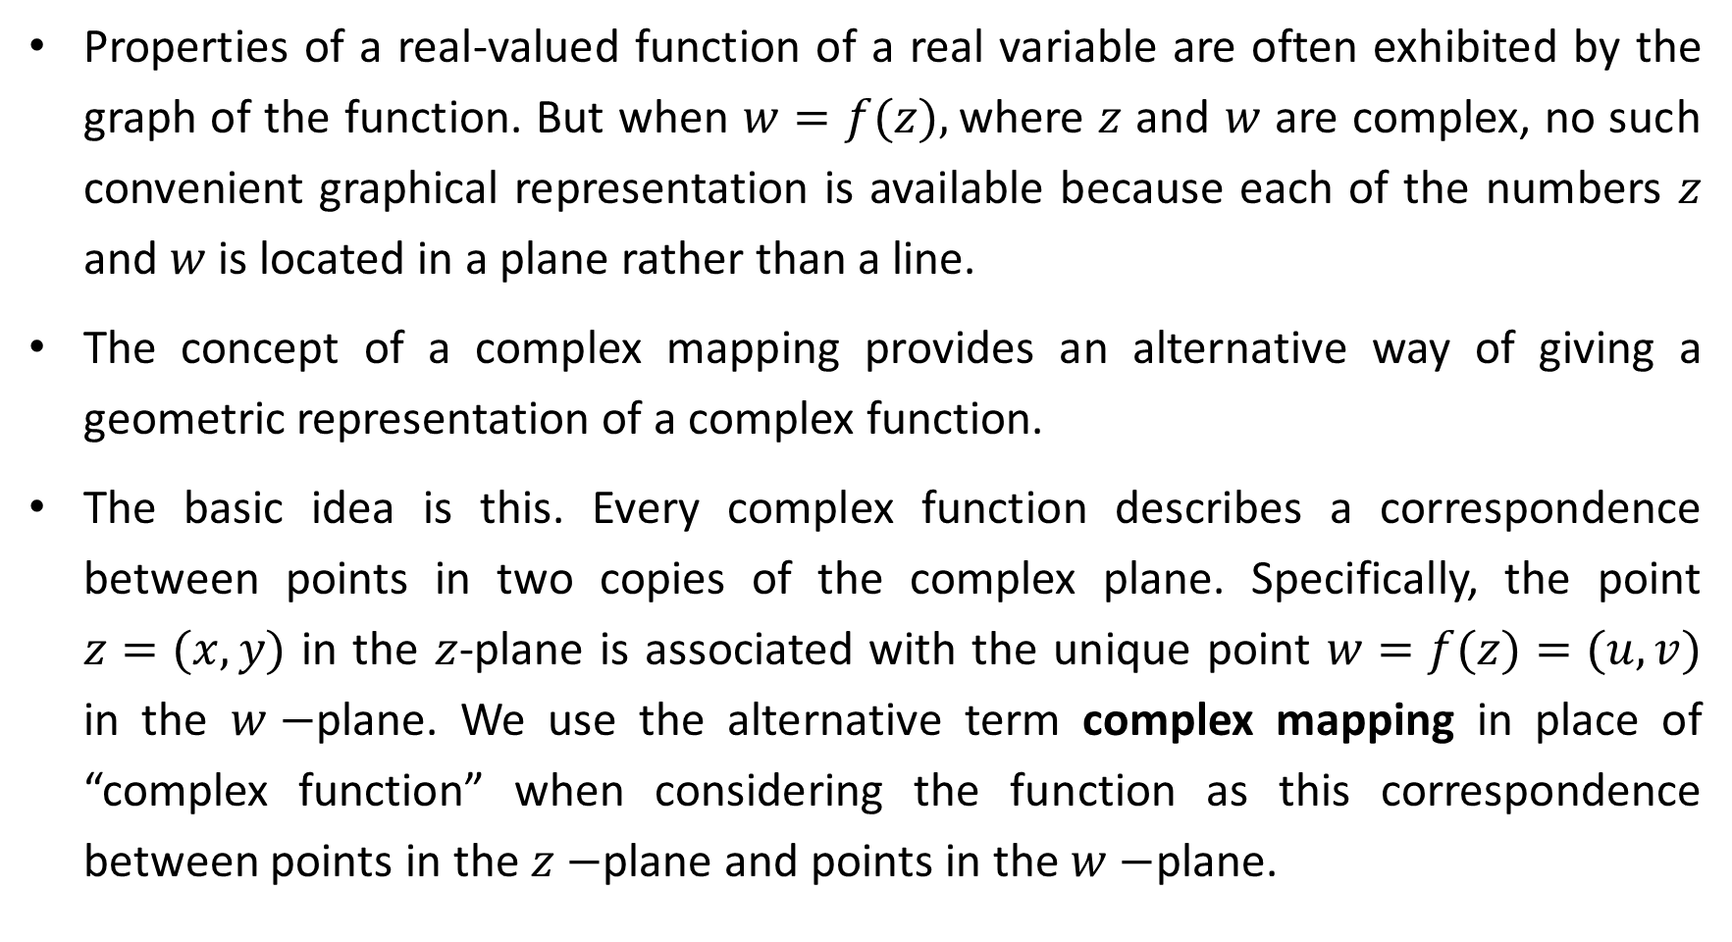
2.2 Complex Functions as Mappings
Properties of a real-valued function of a real variable are often exhibited by the graph of the function. But when $w=f(z),$where $z$ and $w$ are complex, no such convenient graphical representation is available because each of the numbers $z$ and $w$ is located in a plane rather than a line.
The concept of a complex mapping provides an alternative way of giving a geometric representation of a complex function.
The basic idea is this. Every complex function describes a correspondence between points in two copies of the complex plane. Specifically, the point $z=(x,y)$ in the $z$-plane is associated with the unique point $w=f(z)=(u,v)$ in the $w−$plane. We use the alternative term complex mapping in place of “complex function” when considering the function as this correspondence between points in the $z−$plane and points in the $w−$plane.

Slide 14
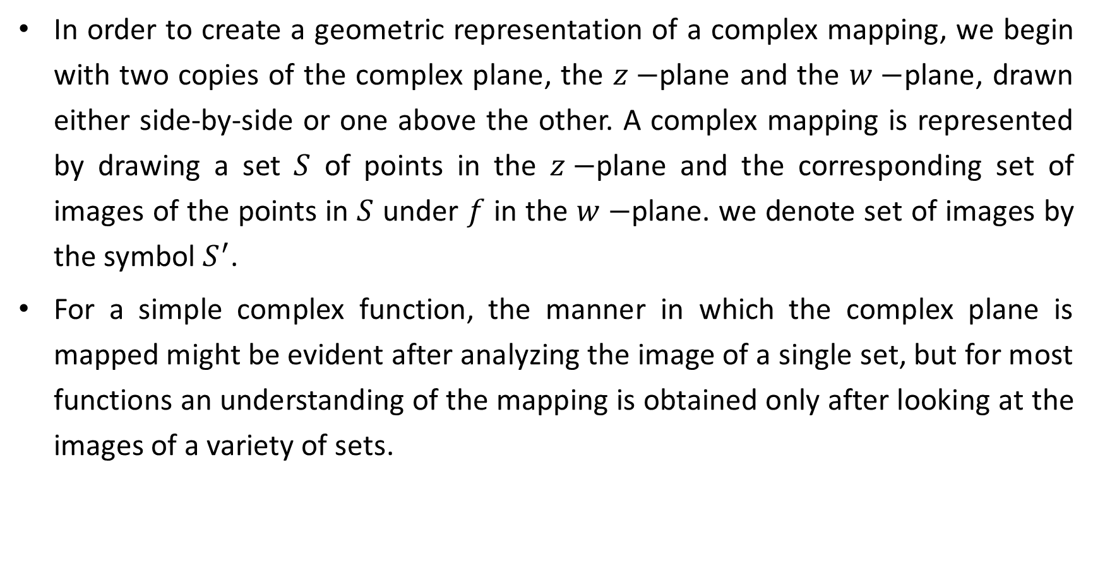
2.2 Complex Functions as Mappings
In order to create a geometric representation of a complex mapping, we begin with two copies of the complex plane, the $z−$plane and the $w−$plane, drawn either side-by-side or one above the other. A complex mapping is represented by drawing a set $S$ of points in the $z−$plane and the corresponding set of images of the points in $S$ under $f$ in the $w−$plane. we denote set of images by the symbol $S^{′}$.
For a simple complex function, the manner in which the complex plane is mapped might be evident after analyzing the image of a single set, but for most functions an understanding of the mapping is obtained only after looking at the images of a variety of sets.

Slide 15
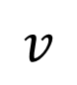
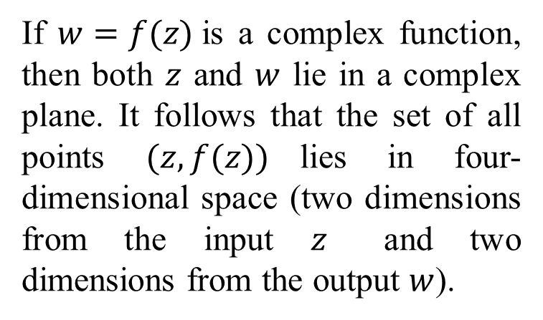
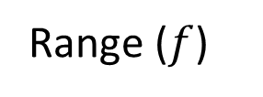
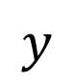

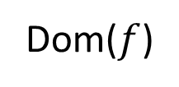
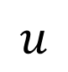
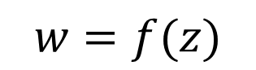
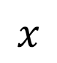
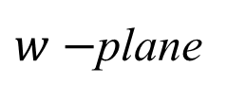
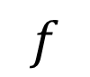
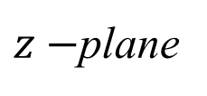
Graph of a real-valued function $f$ is defined to be the set of all points $(x, f(x))$in the two-dimensional Cartesian plane.
$$f$$
Dom($f$)
Range ($f$)
$$y$$
$$v$$
$$w=f(z)$$
If $w=f(z)$is a complex function, then both $z$ and $w$ lie in a complex plane. It follows that the set of all points $(z, f(z))$lies in four-dimensional space (two dimensions from the input $z$ and two dimensions from the output $w$).
$$x$$
$$u$$
domain of definition
range
$z−$plane
$w−$plane

Slide 16
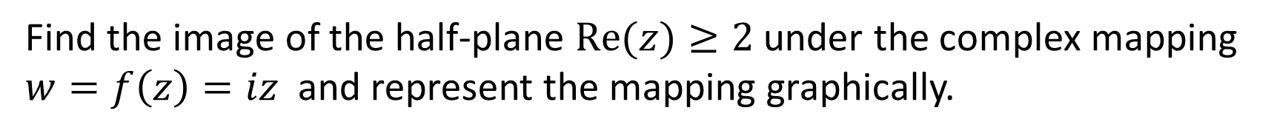
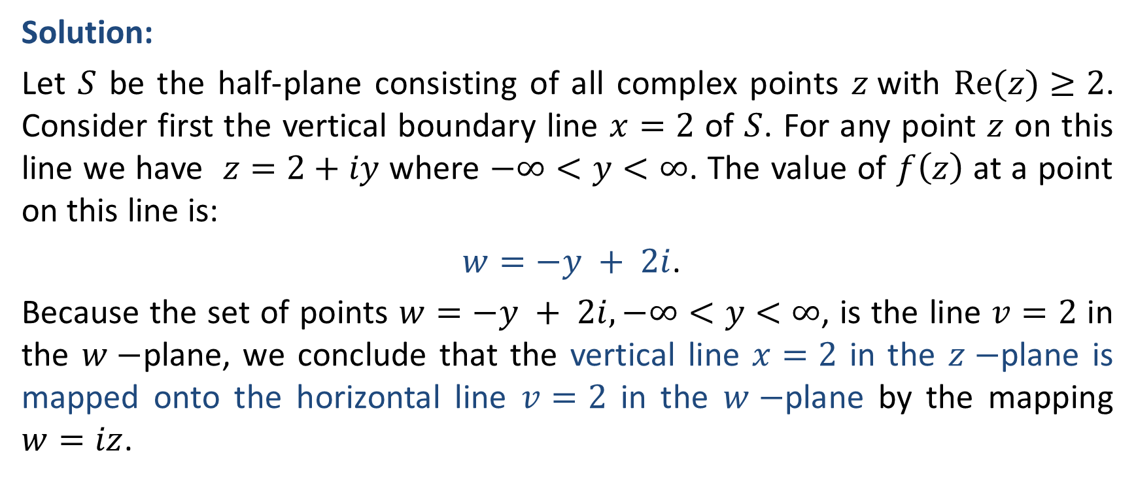
Example:
Find the image of the half-plane $Re(z)≥2$under the complex mapping $w=f\left(z\right)=iz$ and represent the mapping graphically.
Solution:
Let $S$ be the half-plane consisting of all complex points $z$with $Re(z)≥2$. Consider first the vertical boundary line $x=2$ of $S$. For any point $z$ on this line we have $z=2+iy$ where $−∞<y<∞$. The value of $f\left(z\right)$ at a point on this line is:
$w=−y + 2i$.
Because the set of points $w=−y + 2i, −∞<y<∞$, is the line $v=2$ in the $w−$plane, we conclude that the vertical line $x=2$ in the $z−$plane is mapped onto the horizontal line $v=2$ in the $w−$plane by the mapping $w=iz$.

Slide 17
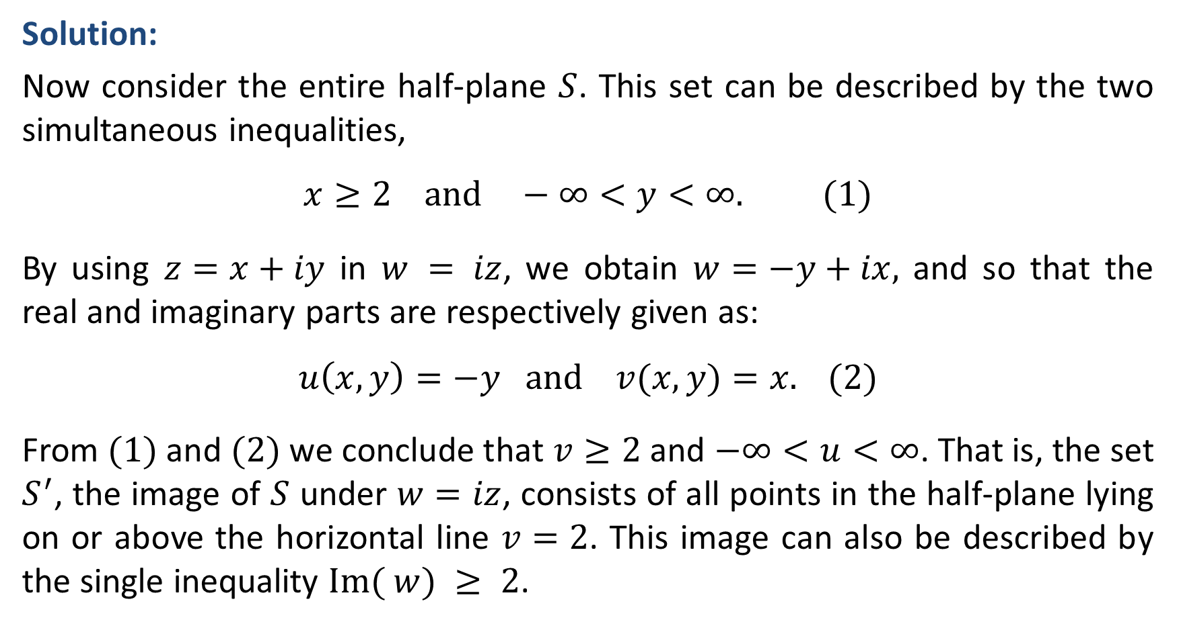
Example:
Solution:
Now consider the entire half-plane $S$. This set can be described by the two simultaneous inequalities,
$$x≥2 and −∞<y<∞. (1)$$
By using $z=x+iy$ in $w = iz$, we obtain $w=−y+ix,$ and so that the real and imaginary parts are respectively given as:
$$u\left(x, y\right)=−y and v(x, y)=x. (2)$$
From $(1)$ and $(2)$ we conclude that $v≥2$ and $−∞<u<∞$. That is, the set $S^{′}$, the image of $S$ under $w=iz$, consists of all points in the half-plane lying on or above the horizontal line $v=2$. This image can also be described by the single inequality $Im( w) ≥ 2$.

Slide 18
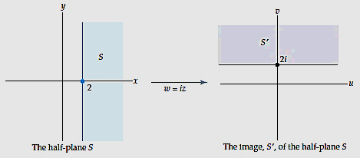

Example:
In summary, the half-plane $Re(z) ≥ 2$ is mapped onto the half-plane $Im(w) ≥ 2$ by the complex mapping $w = iz$.

Slide 19
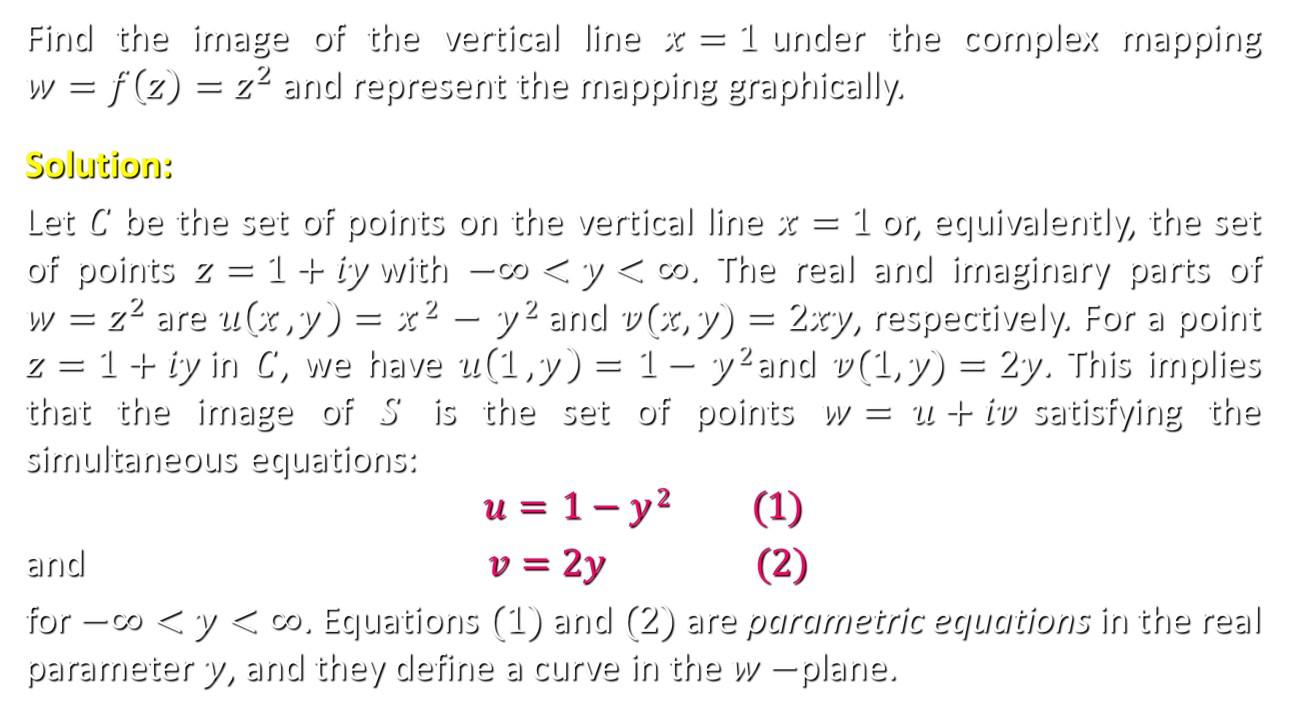
Example:
Find the image of the vertical line $x=1$under the complex mapping $w=f\left(z\right)=z^{2}$and represent the mapping graphically.
Solution:
Let $C$ be the set of points on the vertical line $x=1$or, equivalently, the set of points $z=1+iy$with $−∞<y<∞$. The real and imaginary parts of $w=z^{2}$are $u\left(x , y \right)=x 2 − y 2$ and $v(x, y)=2xy$, respectively. For a point $z=1+iy$in $C$, we have $u\left(1 , y \right)=1− y 2$and $v(1, y)=2y$. This implies that the image of $S$ is the set of points $w= u+iv$satisfying the simultaneous equations:
$$u=1−y 2 (1)$$
and $v=2y (2)$
for $−∞<y<∞$. Equations $(1)$ and $(2)$ are parametric equations in the real parameter $y$, and they define a curve in the $w−$plane.

Slide 20
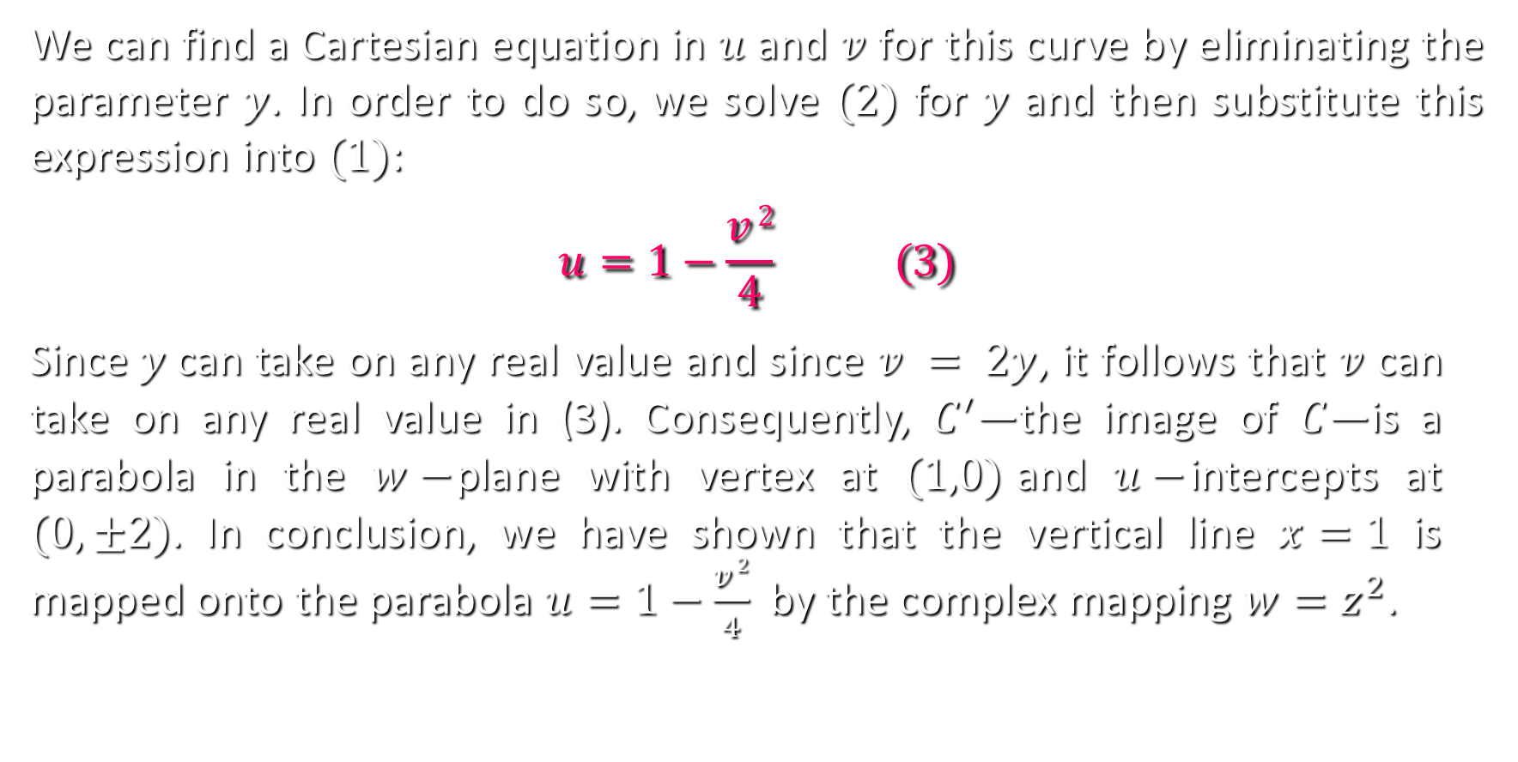
Example:
We can find a Cartesian equation in $u$ and $v$ for this curve by eliminating the parameter $y$. In order to do so, we solve $(2)$ for $y$ and then substitute this expression into $(1)$:
$$u=1−\frac{v 2}{4} (3)$$
Since$y$can take on any real value and since $v = 2y$, it follows that $v$ can take on any real value in (3). Consequently, $C^{′}$—the image of $C$—is a parabola in the $w−$plane with vertex at $(1,0)$and $u−$intercepts at $(0, ±2)$. In conclusion, we have shown that the vertical line $x=1$ is mapped onto the parabola $u=1−\frac{v 2}{4}$ by the complex mapping $w=z^{2}$.

Slide 21
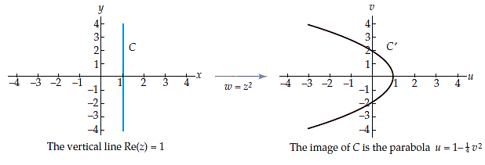
Example:
Note: the representation of the mapping $w=z^{2}$gives little insight into what the images of other sets in the plane might be.

Slide 22
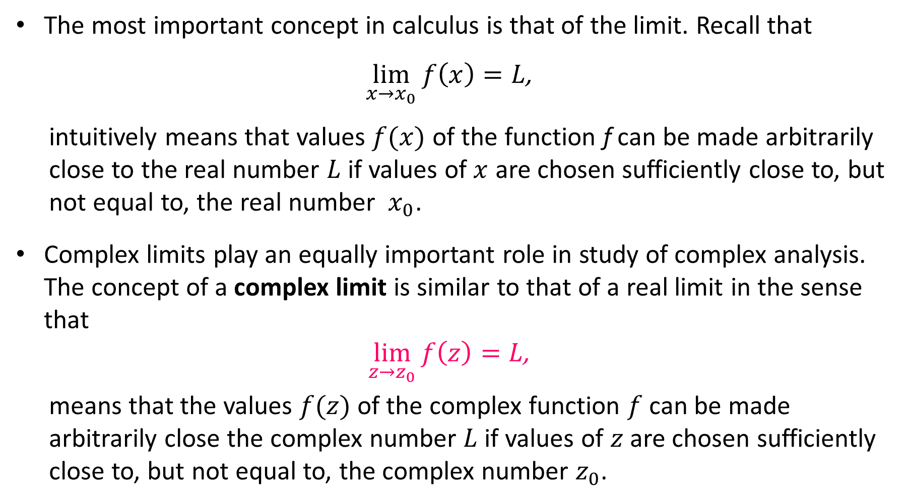
2.6 Limits and Continuity
The most important concept in calculus is that of the limit. Recall that
$$\lim_{x→x_{0}}{f\left(x\right)}=L\text{,}$$
intuitively means that values $f(x)$ of the function f can be made arbitrarily close to the real number $L$ if values of $x$ are chosen sufficiently close to, but not equal to, the real number $x_{0}$.
Complex limits play an equally important role in study of complex analysis. The concept of a complex limit is similar to that of a real limit in the sense that
$$\lim_{z→z_{0}}{f\left(z\right)}=L\text{,}$$
means that the values $f(z)$ of the complex function $f$ can be made arbitrarily close the complex number $L$ if values of $z$ are chosen sufficiently close to, but not equal to, the complex number $z_{0}$.

Slide 23
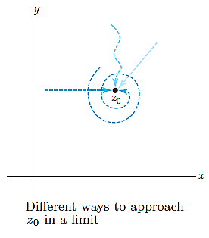
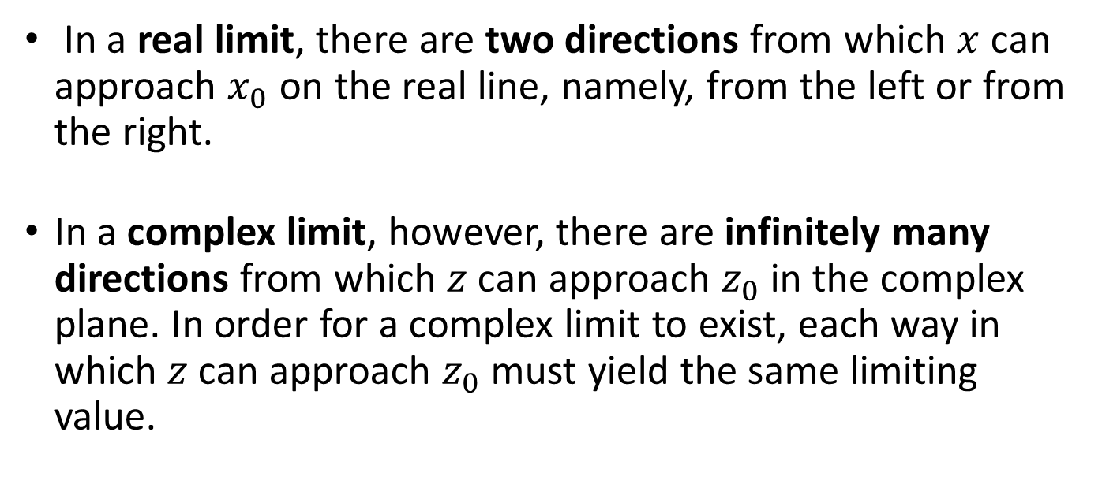
2.6 Limits and Continuity
Note:
Although outwardly similar, there is an important difference between these two concepts of limit.
In a real limit, there are two directions from which $x$ can approach $x_{0}$ on the real line, namely, from the left or from the right.
In a complex limit, however, there are infinitely many directions from which $z$ can approach $z_{0}$ in the complex plane. In order for a complex limit to exist, each way in which $z$ can approach $z_{0}$ must yield the same limiting value.

Slide 24
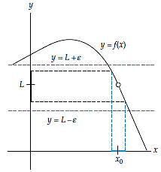
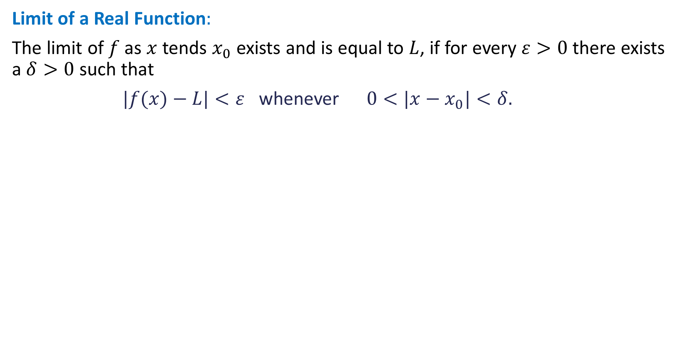
2.6 Limits and Continuity
Limit of a Real Function$:$
The limit of $f$ as $x$ tends $x_{0}$ exists and is equal to $L$, if for every $ε>0$ there exists a $δ>0$ such that
$|f(x)−L|<ε$ whenever $0<|x−x_{0}|<δ.$

Slide 25
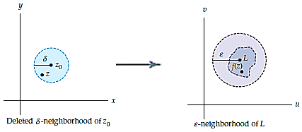
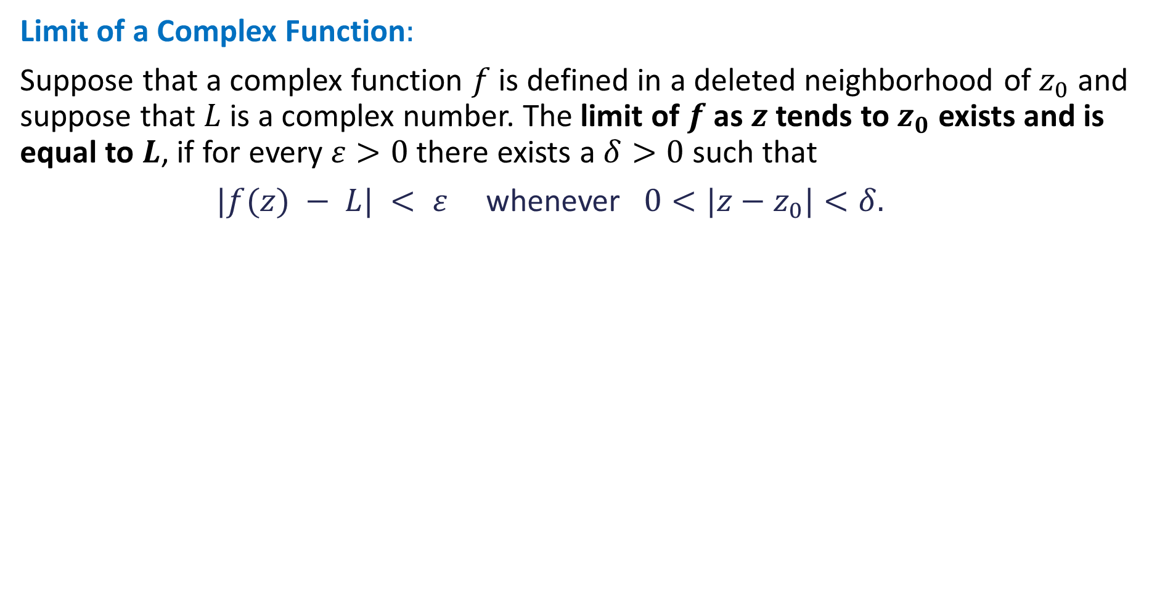
2.6 Limits and Continuity
Limit of a Complex Function$:$
Suppose that a complex function $f$ is defined in a deleted neighborhood of $z_{0}$ and suppose that $L$ is a complex number. The limit of $f$ as $z$ tends to $z_{0}$ exists and is equal to $L$, if for every $ε>0$ there exists a $δ>0$ such that
$|f(z) − L| < ε$ whenever $0<|z−z_{0}|<δ.$

Slide 26
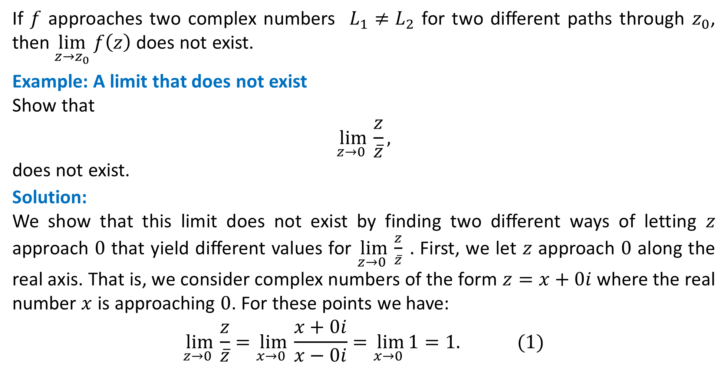
Criterion for the Nonexistence of a Limit
If $f$ approaches two complex numbers $L_{1}≠L_{2}$ for two different paths through $z_{0}$, then $\lim_{z→z_{0}}{f\left(z\right)}$ does not exist.
Example: A limit that does not exist
Show that
$$\lim_{z→0 }{\frac{z}{\overline{z}},}$$
does not exist.
Solution:
We show that this limit does not exist by finding two different ways of letting $z$ approach $0$ that yield different values for $\lim_{z→0 }{\frac{z}{\overline{z}}} .$ First, we let $z$ approach $0$ along the real axis. That is, we consider complex numbers of the form $z=x+0i$where the real number $x$ is approaching $0$. For these points we have:
$$\lim_{z→0 }{\frac{z}{\overline{z}}}=\lim_{x→0 }{\frac{x+0i}{x−0i}}=\lim_{x→0 }1=1. (1)$$

Slide 27
Criterion for the Nonexistence of a Limit
Solution:
On the other hand, if we let $z$ approach $0$ along the imaginary axis, then $z=0+iy$ where the real number $y$ is approaching $0$. For this approach we have:
$$\lim_{z→0 }{\frac{z}{\overline{z}}}=\lim_{y→0 }{\frac{0+yi}{0−yi}}=\lim_{y→0 }\left(−1\right)=−1. (2)$$
Since the values in $(1)$ and $(2)$are not the same, we conclude that $\lim_{z→0 }{\frac{z}{\overline{z}}}$ does
not exist.

Slide 28
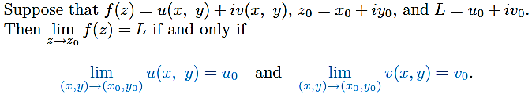
Theorem: Real and Imaginary Parts of a Limit
Real Multivariable Limits
We now study a practical method for computing complex limits in the theorem presented below. This theorem establishes an important connection between the complex limit of $f(z)=u(x,y)+iv(x,y)$ and the real limits of the real-valued functions of two real variables $u(x,y)$ and $v(x,y)$. Since every complex function is completely determined by the real functions $u$ and $v$, it should not be surprising that the limit of a complex function can be expressed in terms of the real limits of $u$ and $v$.

Slide 29
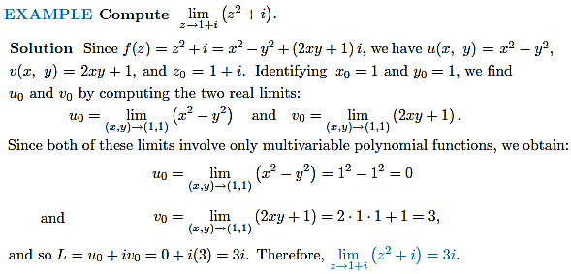
Real and Imaginary Parts of a Limit

Slide 30
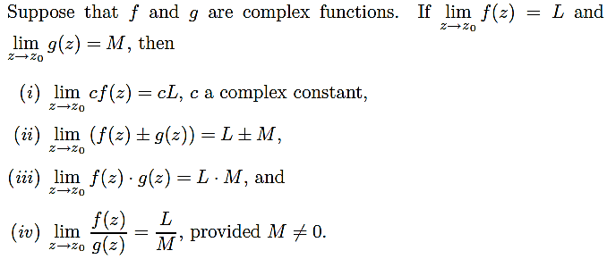
Properties of Complex Limits

Slide 31
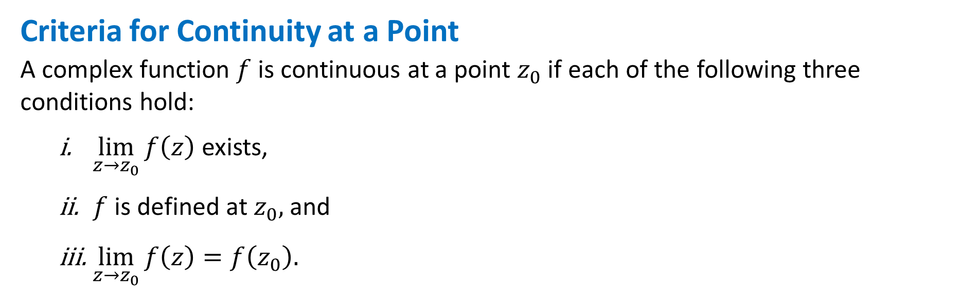
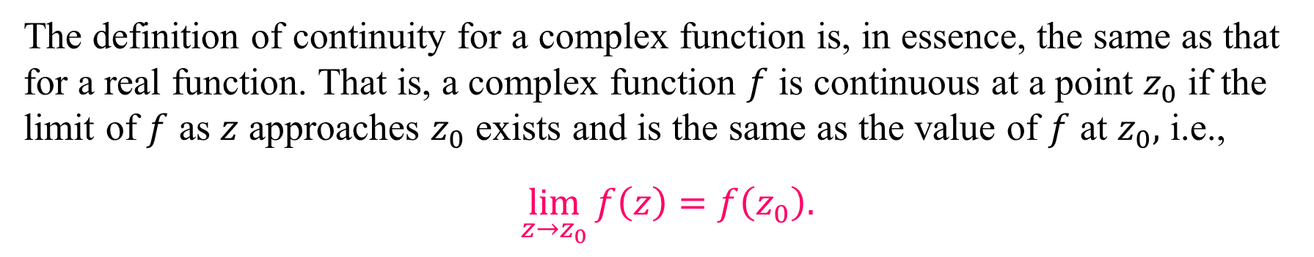
Continuity of Complex Functions
The definition of continuity for a complex function is, in essence, the same as that for a real function. That is, a complex function $f$ is continuous at a point $z_{0}$ if the limit of $f$ as $z$ approaches $z_{0}$ exists and is the same as the value of $f$ at $z_{0},$ i.e.,
$\lim_{z→z_{0}}{f\left(z\right)}=f\left(z_{0}\right).$
Criteria for Continuity at a Point
A complex function $f$ is continuous at a point $z_{0}$ if each of the following three conditions hold:
$\lim_{z→z_{0}}{f\left(z\right)}$ exists,
$f$ is defined at $z_{0},$ and
$\lim_{z→z_{0}}{f\left(z\right)}=f\left(z_{0}\right).$

Slide 32
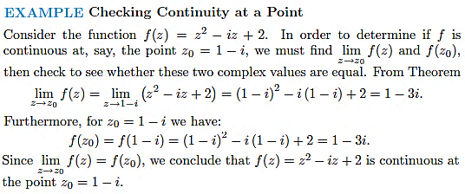
Continuity of Complex Functions

Slide 33

Real and Imaginary Parts of a Continuous Function
Suppose that $f(z)=u(x,y)+iv(x,y)$and $z_{0}=x_{0}+iy_{0}$. Then the complex function $f$is continuous at the point $z_{0}$ if and only if both real functions $u(x,y)$ and $v(x,y)$ are continuous at the point $(x_{0},y_{0}).$
Properties of Continuous Functions

Slide 34
Practice Questions
Exercise 2.6:
Q-1 to Q-17, Q-19, Q-20, Q-27 to Q-40

Slide 35
3
Analytic Functions
Book: A First Course in Complex Analysis with Applications by Dennis G. Zill and
Patrick D. Shanahan.

Slide 36
Contents
Derivative of Complex Function
Analytic Functions
Cauchy-Riemann Equations
Harmonic Functions
Applications

Slide 37


Derivative of Complex Function
Suppose the complex function $w=f (z),$ is defined in a neighborhood of a point $z_{0}$. The complex derivative of $f$at $z_{0}$, denoted by $f^{′}\text{(}z_{0}\text{)}$, is
$$f^{′}\text{(}z_{0}\text{)} =\lim_{∆z→0}{\frac{f\left(z_{0}+∆z\right)−f\left(z_{0}\right)}{∆z}=\lim_{z→z_{0}}{\frac{f\left(z\right)−f\left(z_{0}\right)}{z−z_{0}},}} (1)$$
provided this limit exists.

Slide 38
Example:
Find the derivative of $f(z)=z^{2}−5z.$
Solution: We solve this by definition. Because we are going to compute the derivative of $f$at any point, we replace $z_{0}$ in (1) by the symbol $z$ and first compute:
$$f\left(z +Δz\right)−f\left(z\right)={\left(z +Δz\right)}^{2} − 5\left(z +Δz\right)−\left(z^{2}−5z\right)$$
$$=z^{2}+2zΔz+{\left(Δz\right)}^{2} −5z−5Δz−z^{2}+5z$$
$$= 2zΔz+{\left(Δz\right)}^{2}−5Δz.$$
So that (1) takes the form:
$$f^{′}\text{(}z\text{)}=\lim_{∆z→0}{\frac{2zΔz+{\left(Δz\right)}^{2}−5Δz}{∆z}=\lim_{∆z→0}\left(2z+Δz−5\right)=2z−5.}$$
Thus, the required limit is $f(z) = 2z − 5.$
Alternatively, we notice that $f(z)=z^{2}−5z$ is a complex polynomial function and is
differentiable therefore by using rules of differentiation we have:
$$f^{′}\text{(}z\text{)}=\frac{d}{dz}(z^{2}−5z){=2z−5.}$$

Slide 39
Example:
Check the differentiability of the function $f(z)=\overline{z}$.
Solution: We first calculate:
$$f\left(z +Δz\right)−f\left(z\right)=\overline{z +Δz}−\overline{z}=\overline{z}+\overline{∆z}−\overline{z}=\overline{∆z}.$$
So that (1) takes the form:
$$f^{′}\text{(}z\text{)}=\lim_{∆z→0}{\frac{\overline{∆z}}{∆z}=\lim_{(∆x,∆y)→(0,0)}\frac{\overline{∆x+i∆y}}{∆x+i∆y}=\lim_{(∆x,∆y)→(0,0)}\frac{∆x−i∆y}{∆x+i∆y}.}$$
Follow a path along $x−$axis, where $∆y=0,$ we have
$$f^{′}\text{(}z\text{)}=1. (I)$$
On the other hand, if we let $Δz→0$ along a line parallel to the $y−$axis, then $Δx=0$ and we get
$$f^{′}\text{(}z\text{)}=−1. (II)$$
In view of the obvious fact that the values in $(I)$and $(II)$are different, we conclude that $f(z)=\overline{z}$ is not differentiable at any point $z$.
Practice: Show that the function $f(z)={|z|}^{2}$ is differentiable at $z=0$ but is not differentiable anywhere else. Hint: ${|z|}^{2}=z\overline{z.}$

Slide 40

Analytic Functions
Even though the requirement of differentiability is a stringent demand, there is a class of functions that is of great importance whose members satisfy even more severe requirements. These functions are called analytic functions.
Note: Analyticity at a point is not the same as differentiability at a point. Analyticity at a point is a neighborhood property; in other words, analyticity is a property that is defined over an open set.
For example: the function $f(z)={|z|}^{2}$ is differentiable at $z=0$ but it is not analytic at that point because there exists no neighborhood of $z=0$ throughout which $f$ is differentiable; hence the function $f(z)={|z|}^{2}$is nowhere analytic.

Slide 41
Important facts about Analytic Functions
Analyticity implies differentiability but converse is not true.
A function that is analytic at every point $z$ in the complex plane is said to be an entire function.
A polynomial function $p\left(z\right)=a_{n}z^{n}+a_{n−1}z^{n−1}+… +a_{1}z+a_{0},$ where $n$ is a nonnegative integer, is an analytic function.
A rational function $f(z)=\frac{p(z) }{q(z) }$, where $p(z)$ and $q(z)$ are polynomial functions, is analytic in any domain $D$ that contains no point $z_{0}$ for which $q(z_{0})=0$.
The sum $f(z)+g(z),$difference $f(z)−g(z),$and product $f(z)g(z)$ are analytic. The quotient $f(z)/g(z)$is analytic provided $g(z)≠0$ in $D$.
A point $z$ at which a complex function $w=f(z)$ fails to be analytic is called a singular point of $f$. For example: the function $f(z)=\frac{z}{z^{2}+1}$ is not analytic at $z=±i$; hence $z=±i$ are the singular points of $f.$

Slide 42

Cauchy-Riemann Equations
A complex function $w=f (z),$ is said to be analytic in a domain $D$ if it differentiable at all points in $D$. In order to find out if a complex function is analytic it is not possible to check differentiability at each point. Therefore an analytic criteria is required to establish analyticity of a complex function. This criteria was first used by Cauchy and later it was formally formulated by Riemann which now known as Cauchy-Riemann equations.
Criterion for Analyticity: Suppose the real functions $u(x, y)$and $v(x, y)$are continuous and have continuous first-order partial derivatives in a domain $D$. If $u$ and $v$ satisfy the Cauchy-Riemann equations (CR-equations):
$$\frac{∂u}{∂x }=\frac{∂v}{∂y } and \frac{∂u}{∂y }=−\frac{∂v}{∂x }, (1)$$
at all points of $D$, then the complex function $f(z)=u(x, y)+iv(x, y)$ is analytic in $D$.
Remark: The CR-equations are not only necessary condition for a function to be analytic but are also sufficient condition.

Slide 43

Example:
Determine if the function $f\left(z\right)=z^{2}$ is analytic or not?
Solution: The above function can be written as $f\left(z\right)=z^{2}=\left(x^{2}−y^{2}\right)+i\left(2xy\right),$ so that
$u\left(x,y\right)=x^{2}−y^{2}$ and $v\left(x,y\right)=2xy.$
Calculating the partial derivatives of above functions, we get:
$$u_{x}=2x, u_{y}=−2y,$$
$v_{x}=2y, v_{y}=2x,$
Note that:
$$u_{x}=v_{y} and u_{y}=−v_{x}.$$
Since CR-equations are satisfied, therefore, we conclude that the given function is analytic.
Note: By using the fact that analyticity implies differentiability we can say that the given function is differentiable everywhere.

Slide 44

Example:
Determine the points where function $f\left(z\right)=\frac{1}{z−1}$ is not analytic.
Solution: The above function can be decomposed as:
$u\left(x,y\right)=\frac{x−1}{{(x−1)}^{2}+y^{2}}$ and $v\left(x,y\right)=\frac{−y}{{(x−1)}^{2}+y^{2}}.$
the real functions $u\left(x,y\right)=\frac{x−1}{{(x−1)}^{2}+y^{2}}$ and $v\left(x,y\right)=\frac{−y}{{(x−1)}^{2}+y^{2}}$ are continuous except at the point $z=1$. Moreover, the first four first-order partial derivatives
$$u_{x}=\frac{y^{2}−{(x−1)}^{2}}{{(x−1)}^{2}+y^{2}}, u_{y}=\frac{−2y(x−1)}{{(x−1)}^{2}+y^{2}},$$
$$v_{x}=\frac{2y(x−1)}{{(x−1)}^{2}+y^{2}}, v_{y}=\frac{y^{2}−{(x−1)}^{2}}{{(x−1)}^{2}+y^{2}},$$
are continuous except at $z=1$. Finally, we see from
$$u_{x}=v_{y} and u_{y}=−v_{x},$$
that the CR-equations are satisfied except at $z=1.$ Thus, we conclude that $f$ is analytic in any domain $D$ that does not contain the point $z=1$.

Slide 45
Criterion for Non-analyticity:
If the CR-equations (1) are not satisfied at every point $z$ in a domain $D$, then the function $f(z)=u(x, y)+iv(x, y)$ cannot be analytic in $D$.
Example: We know that the function $f\left(z\right)=\overline{z}$ is not analytic anywhere in the $z−$plane. We verify this result using CR-equations. Note that the function $f\left(z\right)=\overline{z}$ can be decomposed as:
$u\left(x,y\right)=x$ and $v\left(x,y\right)=−y.$
From where we get:
$$u_{x}=1, u_{y}=0,$$
$v_{x}=0, v_{y}=−1,$
Note that:
$$u_{x}≠v_{y},$$
reflecting that the CR-equations are not satisfied. Since the above relation is valid at all points in the domain therefore the function is not analytic anywhere in the $z−$plane.

Slide 46


Cauchy-Riemann Equations in Polar Coordinates
For complicated complex functions it is better to use Euler’s formula which require that the CR-equations are obtained in $(r,θ)$. The Cauchy-Riemann equations in polar coordinates are given by:
$\frac{∂u}{∂r }=\frac{1}{r}\frac{∂v}{∂θ} and \frac{∂v}{∂r }=−\frac{1}{r}\frac{∂u}{∂θ}, (2)$
Example: Let $f\left(z\right)=\frac{1}{z}=\frac{1}{x+iy}.$ In polar coordinates the function $f(z)$ can be written as:
$$f\left(z\right)=\frac{1}{re^{iθ}}=\frac{e^{−iθ}}{r}=\frac{\cos{θ}−i\sin{θ}}{r},$$
So that $u\left(r,θ\right)=\frac{\cos{θ}}{r}$ and $v\left(r,θ\right)=\frac{− sin{θ}}{r}.$ From where we get:
$$u_{r}=\frac{−cos{θ}}{r^{2}}, u_{θ}=\frac{− sin{θ}}{r},$$
$v_{r}=\frac{\sin{θ}}{r^{2}}, v_{θ}=\frac{− cos{θ}}{r}.$
Note that:$u_{r}=\frac{1}{r}v_{θ} and v_{r}=−\frac{1}{r}u_{θ}.$ Since CR-equations are satisfied, therefore, we conclude that the given function is analytic.

Slide 47
Sufficient Conditions for Differentiability
Remark:
Since, the CR-equations are necessary condition for the existence of the derivative of a function $f$ at a point $z$, they can often be used to locate points at which$f$does not have a derivative.
Examples:
For the function $f\left(z\right)={|z|}^{2},$ we have, $u\left(x,y\right)=x^{2}+y^{2}$ and $v\left(x,y\right)=0.$ If CR-equations are to hold at a point $\left(x,y\right),$ it follows that $2x=0$ and $2y=0⇒x=y=0.$ Consequently, $f^{′}(z)$ does not exists at any non-zero point.
For the function $f\left(z\right)=e^{z},$ we can easily show that $f$is differentiable everywhere and $f^{′}\left(z\right)=e^{z}$

Slide 48
Practice Questions:
Determine if the following complex function are analytic:
$f\left(z\right)=e^{z}$
$f\left(z\right)=e^{\overline{z}}$
$f\left(z\right)=\sin{z}$
$f\left(z\right)=z^{6}$
$f\left(z\right)=z^{−2}$

